Slide 1

Generative Adversarial Network (GAN)
Binyang Song
The School of Engineering Design, Technology, and Professional Programs (SEDTAPP)
PennState
IMECE
Hackathon Tutorial (2)

Slide 2
Outline
What is GAN?
Formulations of GANs
Applications of GANs

Slide 3
Outline
What is GAN?
Formulations of GANs
Applications of GANs

Slide 4
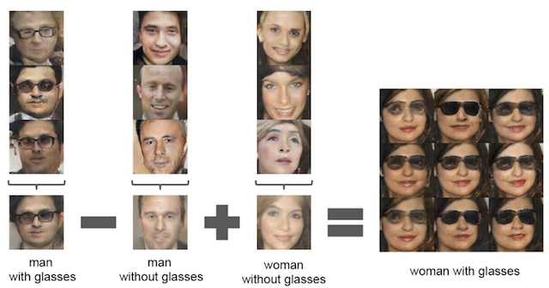
What is GAN?

Slide 5
What is GAN?

Slide 6
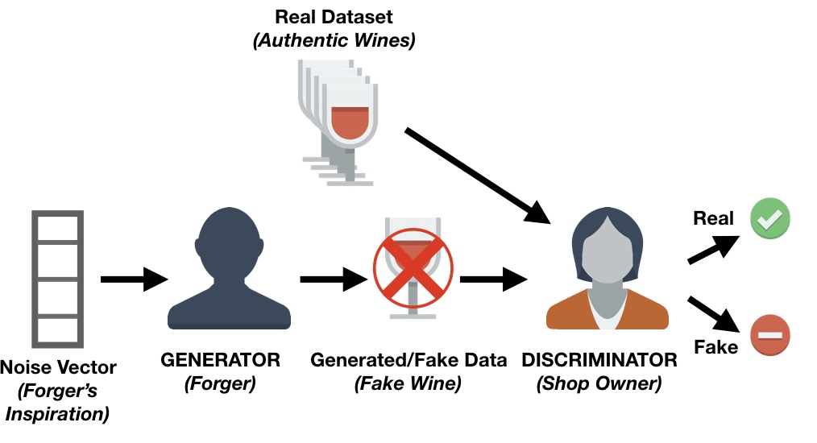
What is GAN?
Generative
A generative model
Adversarial
Trained in an adversarial setting
Network
Use deep neural networks

Slide 7
What is GAN?
https://www.datacamp.com/community/tutorials/generative-adversarial-networks

Slide 8
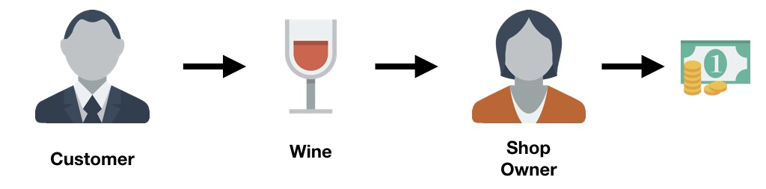
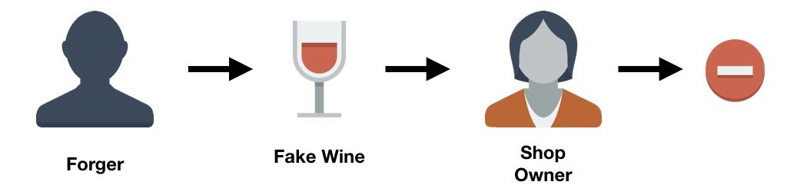
What is GAN?
https://www.datacamp.com/community/tutorials/generative-adversarial-networks

Slide 9
What is GAN?
https://www.datacamp.com/community/tutorials/generative-adversarial-networks

Slide 10
Outline
What is GAN?
Formulations of GANs
Applications of GANs

Slide 11
GANs’ Architecture
https://slazebni.cs.illinois.edu/spring17/lec11_gan.pdf

Slide 12
Discriminator
1
0

Slide 13
Error Function
1
Low error
Prediction
0
High error

Slide 14
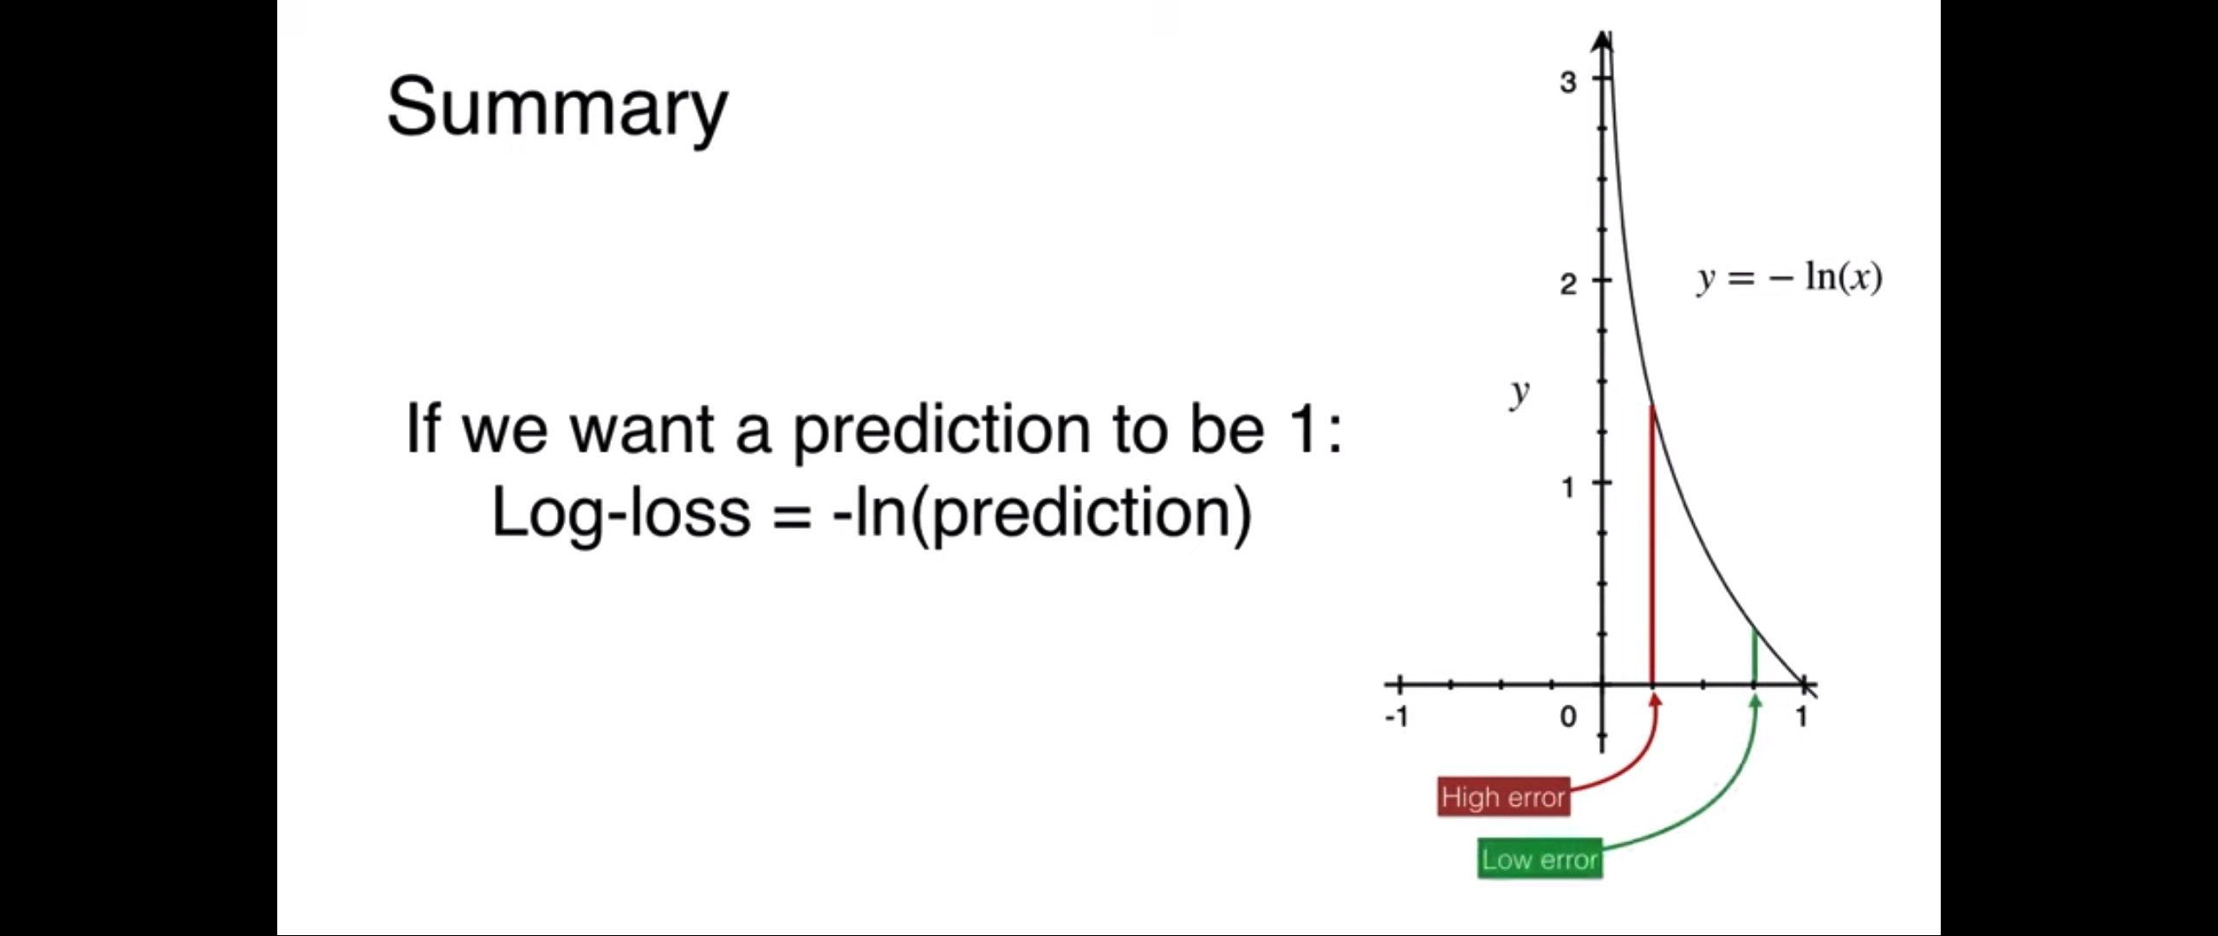
Error Function
1
Low error
y = -log(x)
Prediction
0
High error
Log-loss = -log(prediction)

Slide 15
Cost Function: Discriminator
1
y = -log(D(x))
Low Error
0
y = -log(DG(z))
High Error
y = -log(x)

Slide 16
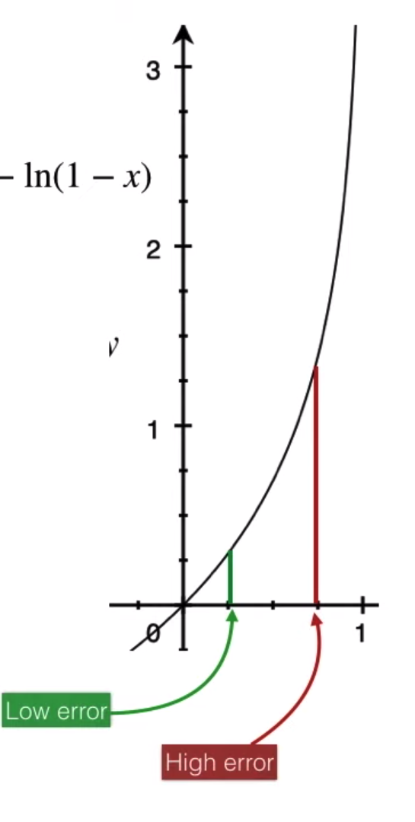
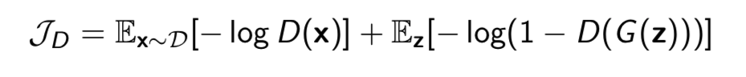
Cost Function: Discriminator
1
y = -log(D(x))
Low Error
y = -log(1-x)
0
y = -log(D(G(z)))
High Error
y = -log(x)
y = -log(1-D(G(z)))
Low Error

Slide 17
Generator
1

Slide 18
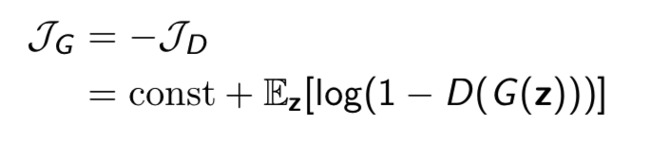
Cost Function: Generator
1
Low error
Prediction

Slide 19
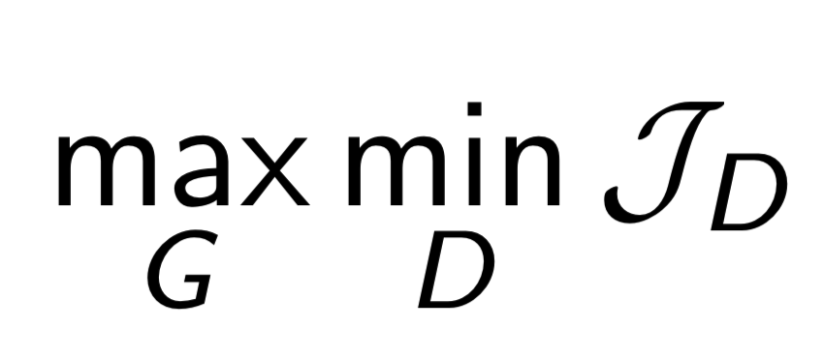
GANs’ Formulation
The Discriminator is trying to minimize its cost.
The Generator is trying to maximize Discriminator’s cost (or minimize its reward).

Slide 20
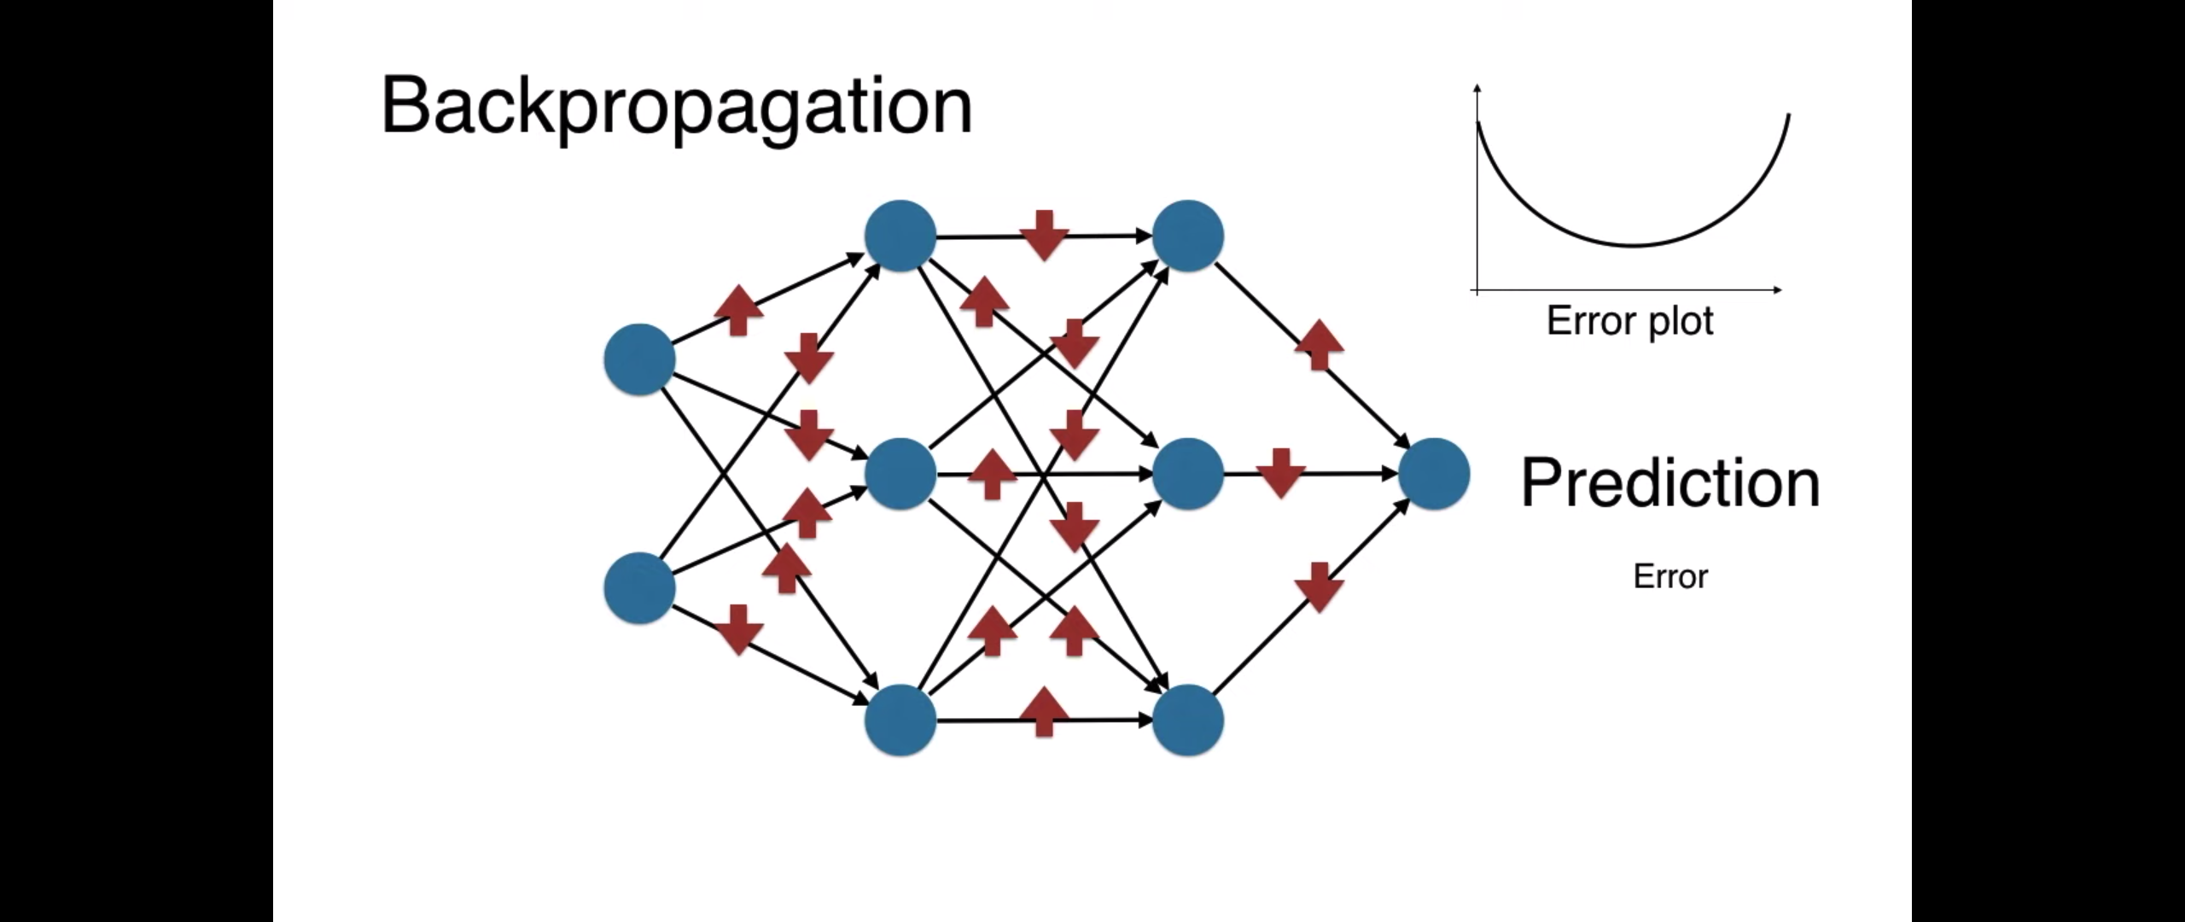
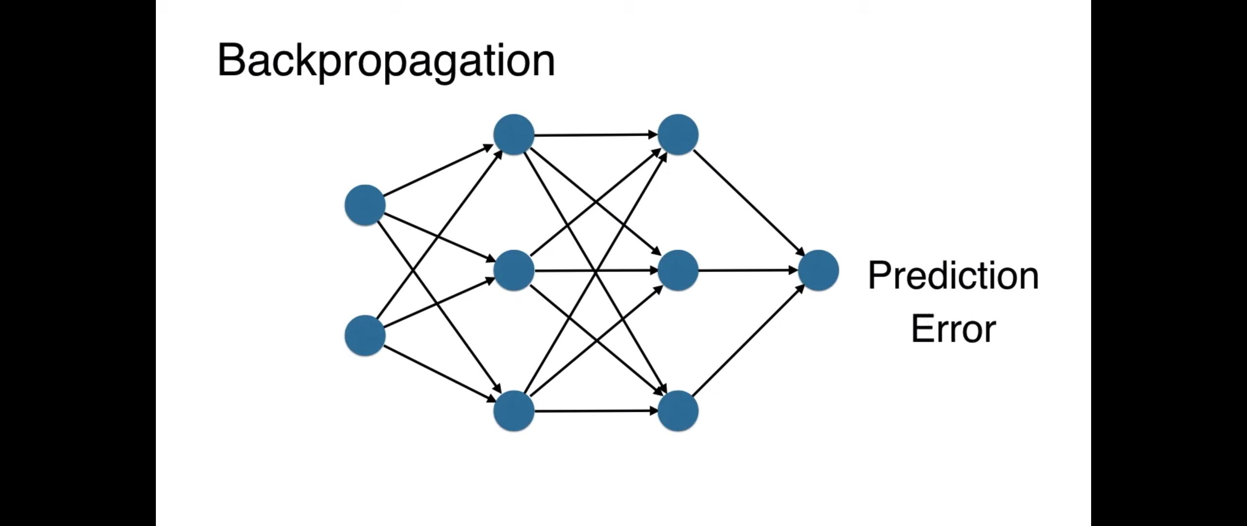
Training: Backpropagation
Weight
Input

Slide 21
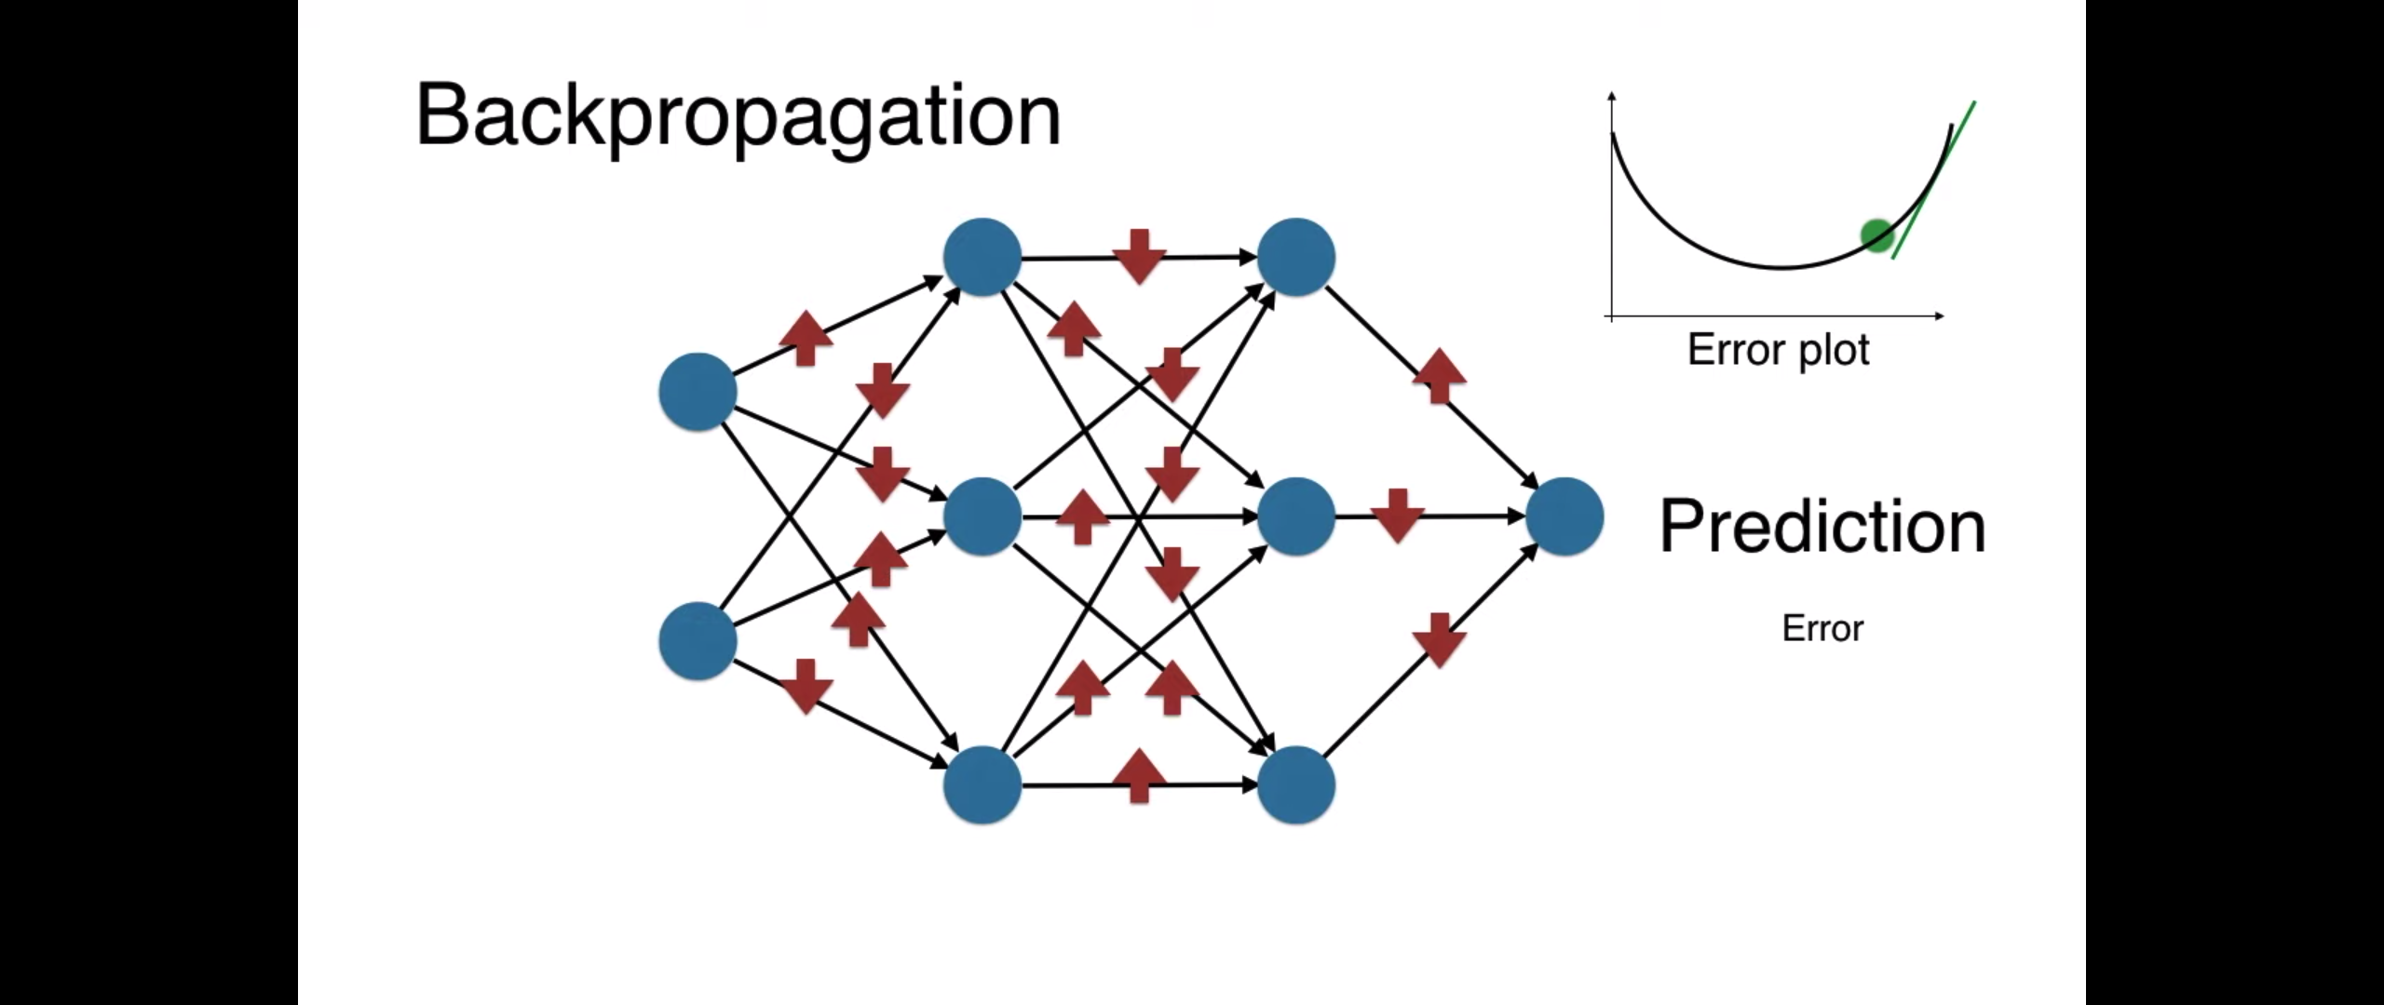
Training: Backpropagation
Weight
Input

Slide 22
Training: Backpropagation
https://slazebni.cs.illinois.edu/spring17/lec11_gan.pdf

Slide 23
Vanishing Gradient
https://www.cs.toronto.edu/~rgrosse/courses/csc321_2018/slides/lec19.pdf

Slide 24
Modified Cost Function

Slide 25
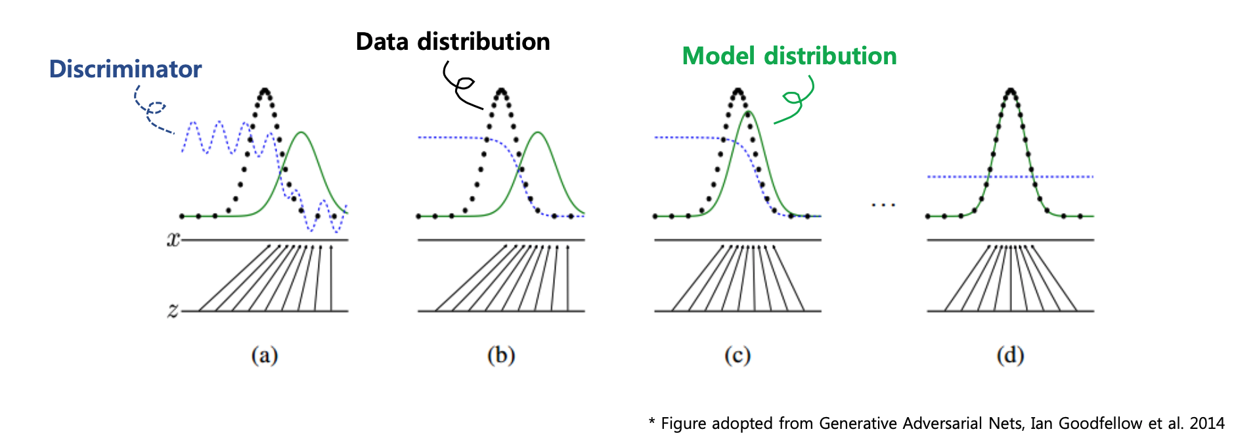
Update

Slide 26
Outline
What is GAN?
Formulations of GANs
Applications of GANs

Slide 27
Application: Image-to-image Translation
Isola, P., Zhu, J. Y., Zhou, T., & Efros, A. A. “Image-to-image translation with conditional adversarial networks”. arXiv preprint arXiv:1611.07004. (2016).

Slide 28
Application: Text-to-image Synthesis
Reed, S., Akata, Z., Yan, X., Logeswaran, L., Schiele, B., & Lee, H. “Generative adversarial text to image synthesis”. ICML (2016).

Slide 29
Application: Face Aging with Conditional GANs
Antipov, G., Baccouche, M., & Dugelay, J. L. (2017). “Face Aging With Conditional Generative Adversarial Networks”. arXiv preprint arXiv:1702.01983.

Slide 30
Video Tutorials on GANS (YouTube)
A Friendly Introduction to Generative Adversarial Networks (GANs)
An Introduction to Generative Adversarial Networks (GANs)
…

Slide 31
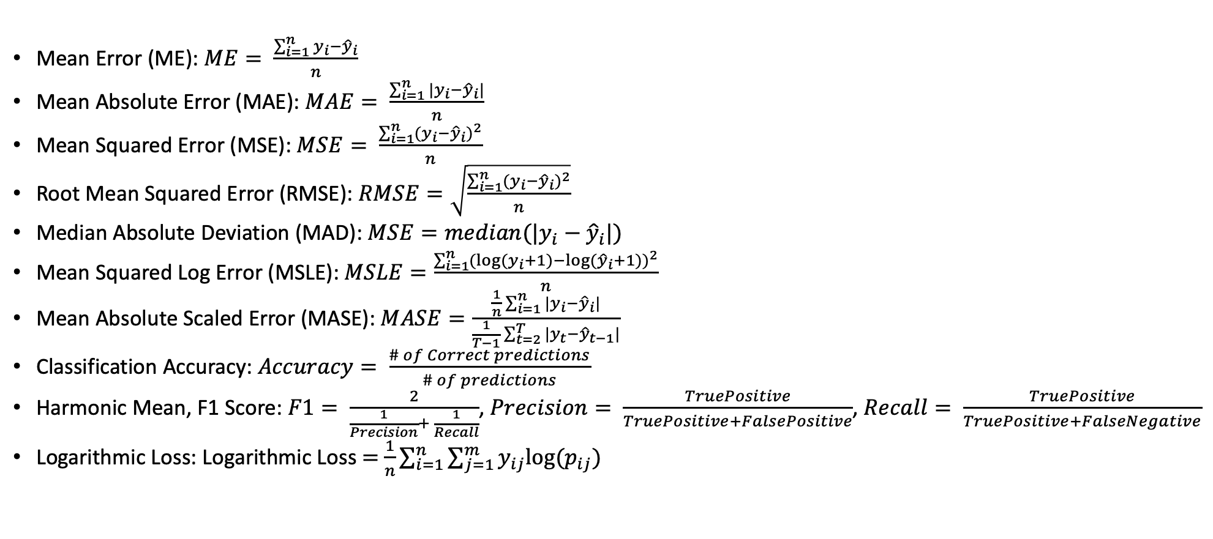
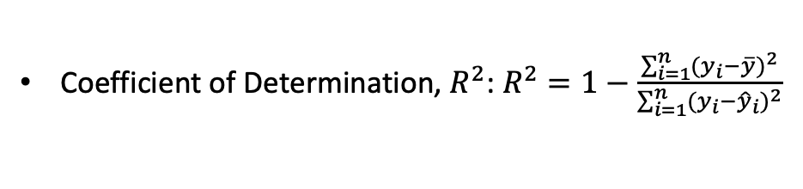
Prediction Accuracy Metrics
Coefficient of Determination, $R^{2}$: $R^{2}=1−\frac{\sum_{i=1}^{n}{{{(y}_{i}−\overline{y})}^{2}}}{\sum_{i=1}^{n}{{{(y}_{i}−{\hat{y}}_{i})}^{2}}}$
Mean Error (ME): $ME= \frac{\sum_{i=1}^{n}{y_{i}−{\hat{y}}_{i}}}{n}$
Mean Absolute Error (MAE): $MAE= \frac{\sum_{i=1}^{n}{|y_{i}−{\hat{y}}_{i}|}}{n}$
Mean Squared Error (MSE): $MSE= \frac{\sum_{i=1}^{n}{{{(y}_{i}−{\hat{y}}_{i})}^{2}}}{n}$
Root Mean Squared Error (RMSE): $RMSE=\sqrt{\frac{\sum_{i=1}^{n}{{{(y}_{i}−{\hat{y}}_{i})}^{2}}}{n}}$
Median Absolute Deviation (MAD): $MSE=median(|y_{i}−{\hat{y}}_{i}|)$
Mean Squared Log Error (MSLE): $MSLE=\frac{\sum_{i=1}^{n}{{{(log⁡(y}_{i}+1)−log⁡({\hat{y}}_{i}+1))}^{2}}}{n}$
Mean Absolute Scaled Error (MASE): $MASE=\frac{\frac{1}{n}\sum_{i=1}^{n}{|y_{i}−{\hat{y}}_{i}|}}{\frac{1}{T−1}\sum_{t=2}^{T}{|y_{t}−{\hat{y}}_{t−1}|}}$
Classification Accuracy: $Accuracy= \frac{\# of Correct predictions}{\# of predictions}$
Harmonic Mean, F1 Score: $F1= \frac{2}{\frac{1}{Precision}+ \frac{1}{Recall}}$, $Precision= \frac{TruePositive}{TruePositive+FalsePositive}$, $Recall= \frac{TruePositive}{TruePositive+FalseNegative}$
Logarithmic Loss: Logarithmic Loss $=$ $\frac{1}{n}\sum_{i=1}^{n}{\sum_{j=1}^{m}{y_{ij}log⁡(p_{ij})}}$

Slide 32
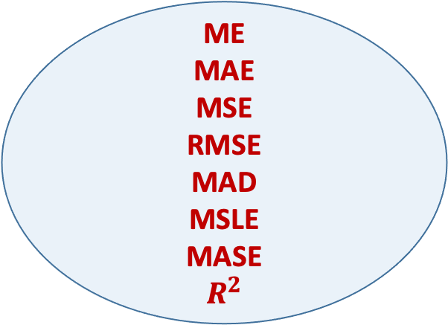
Application
Accuracy Evaluation in Regression
Accuracy Evaluation in Classification
ME
MAE
MSE
RMSE
MAD
MSLE
MASE
$$R^{2}$$
Precision
Recall
F1 Score
Classification Accuracy
Confusion Matrix
Logarithmic Loss
Scale independent, applicable to different time series.

Slide 33
Thank you! Questions?
Binyang Song, STEDAPP
PennState, bqs5667@psu.ed
IMECE
Hackathon Tutorial (2)

